Slide 1


Adaptive cruise control (ACC) Modular kit
Customer communication material
Released Version: October 2021 – All displayed information subject to change

Slide 2

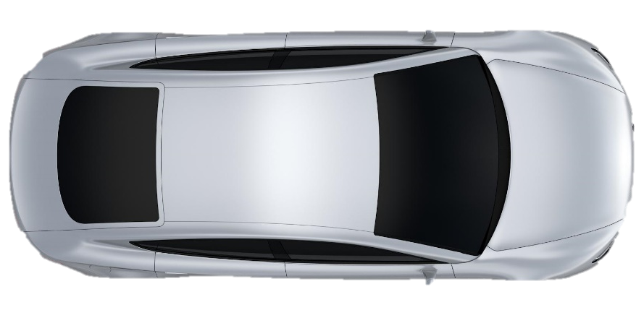
The longitudinal control in SAE Level 1 & 2
Adaptive cruise control
The Adaptive cruise control extends the standard cruise control with an automatic adjustment of the speed and distance to the preceding vehicle.
deceleration
acceleration
distance

Slide 3
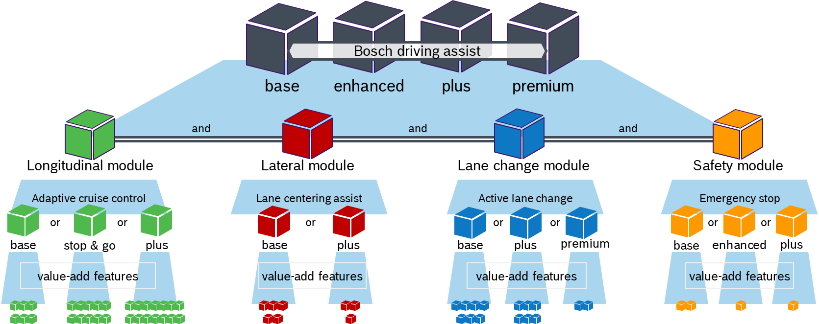
…Bosch driving assist - modular kit
Adaptive cruise control is part of the…
Level 2
Level 1

Slide 4
Features & Value-add features → Portfolio → Roadmap → Upgrades over time

Slide 5
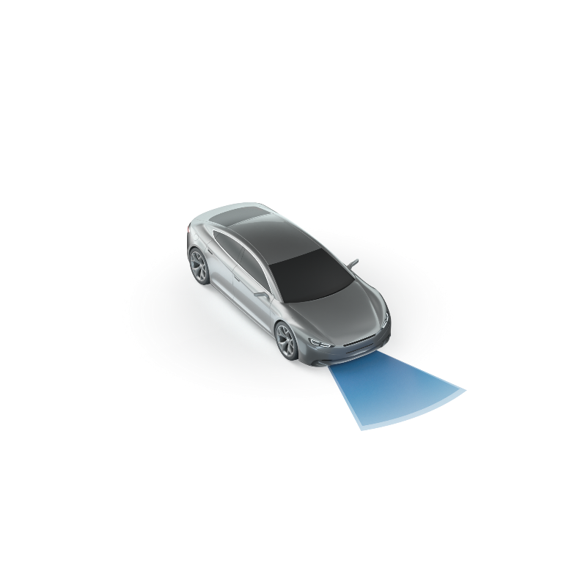
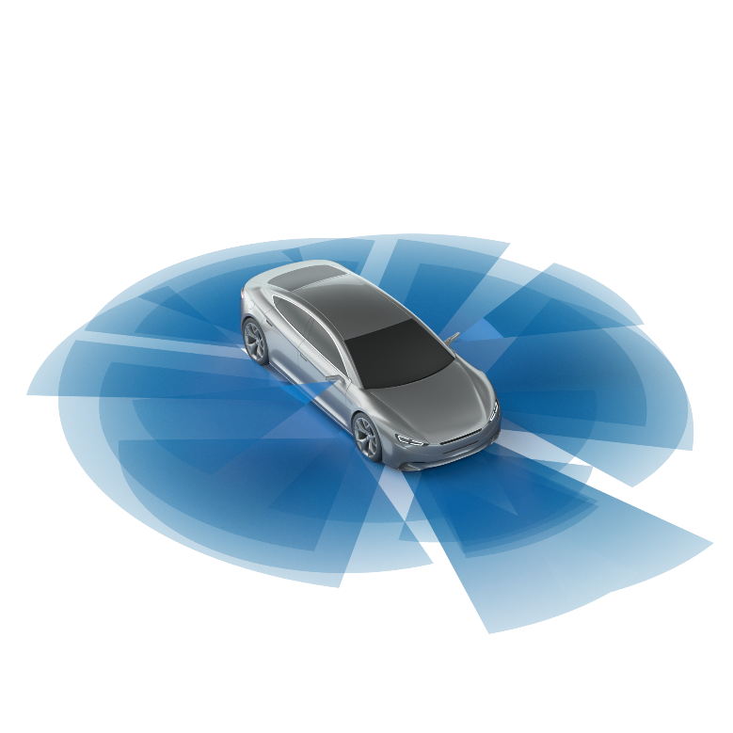
Main features in series production
Adaptive cruise control portfolio
Adaptive cruise control
plus
In series
Implicit and explicit speed signs are recognized (with feature: Road sign information)
Predictive and comfortable speed adaptations before curves (optional value-add available for more complex use cases, like intersections)
Automatic or confirmed adaptation modes supported
In series
Adaptive cruise control
stop & go
In series
Speed range: 0 kph – 250 kph (max. speed depending on sensor set)
Automatic resume within 3s after ego vehicle stand still
Starts the engine when direct preceding vehicle is driving off
Optional value-add feature: Braking on standing objects available
Adaptive cruise control
base
In series
Speed range: 30 kph – 250 kph (maximum speed depending on sensor set)
Distance to preceding vehicle can be adjusted by driver
Comfortable speed adaptations inside curves (standard value-add feature: Curve speed controller)
Note: Minimum & maximum speed and functional performance depending on sensor set and selected ACC feature

Slide 6
Value-add features – Overview (1/2)
Adaptive cruise control
Adaptive cruise control
base
stop & go
plus
Curve speed controller
s
s
s
Reduction of ego vehicle speed based on lateral acceleration
Personalized drive programs
Different acceleration and deceleration characteristics
Optional: consumption optimized measures
s
s
s
Cooperative behavior
Situation based gap generation to support lane change of neighboring vehicle
Speed adaptation based on driver lane change request and traffic in neighboring lane
o
o
o
Wrong side overtake avoidance
Speed reduction to avoid illegal overtaking on the wrong side
Applies to traffic rules of specific countries
o
o
o
Overtaking support
Speed increase of ego vehicle if driver intends to overtake
Verification against preceding or overtaking vehicles on the neighboring lane
o
o
o
Predictive overtaking support
Foresees the driver intention to change the lane due to an overtaking scenario
Assists the driver by avoiding unnecessary decelerations due to the preceding vehicle
o
o
o
ACC engine start base
Engine starts when preceding vehicle drives-off or when the driver resumes ACC
s
s
s: standard equipped
o: optional
*Concept phase, timing and content not finalized yet

Slide 7
Value-add features – Overview (2/2)
Adaptive cruise control
Adaptive cruise control
stop & go
plus
ACC engine start plus
Initiates the start of the engine when the pre-preceding vehicle drives off
Feature can additionally be active in ACC passive mode
o
o
Adaptation to road radius
Ego vehicle speed is adapted automatically to road radius
Curve radius, intersection, roundabout radius and traffic behavior information are considered
s
Braking on standing objects
ACC reaction on standing object (vehicles)
Brings ego vehicle to standstill; Maximum speed of ego vehicle depending on sensor set
o
s
Automatic resume plus
Re-activates the ACC feature after the ego vehicle came to a complete stop within ACC control and the preceding vehicle drives off
ACC resumes automatically within 30s after ego vehicle standstill
o
o
Adaptive distance control
When driving not in ACC mode the Adaptive distance control ensures a comfortable distance to the preceding vehicle and takes over braking maneuvers
o
o
Considers cloud-based environmental information to adapt safety distance and driving speed to the actual driving condition pro-actively before the vehicle is encountering any dangerous situation
Adaptation to road hazards*
o
s
Right of way support
Warning and reaction to stop/yield signs and red traffic lights
Brings vehicle to a complete stop at red traffic lights
o
Eco drive mode*
Implementation of energy-efficient speed optimization integrated in ADAS architecture
o
s: standard equipped
o: optional
*Concept phase, timing and content not finalized yet

Slide 8
Value-add feature Roadmap
Adaptive cruise control
Note: Value-add feature description and versioning attached as one-pager in the chapter “Value-add feature description”

Slide 9

Upgrades over time
Adaptive cruise control
Features can be upgraded over time to production vehicles or field vehicles using…
… production software updates or
… over the air vehicle software updates
… and diverse business models like:
traditional running change model
regular maintenance model

Slide 10
Feature description

Slide 11

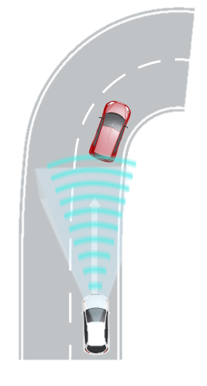
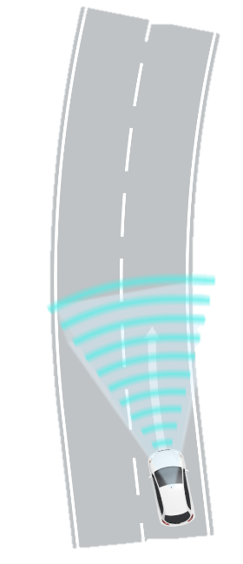
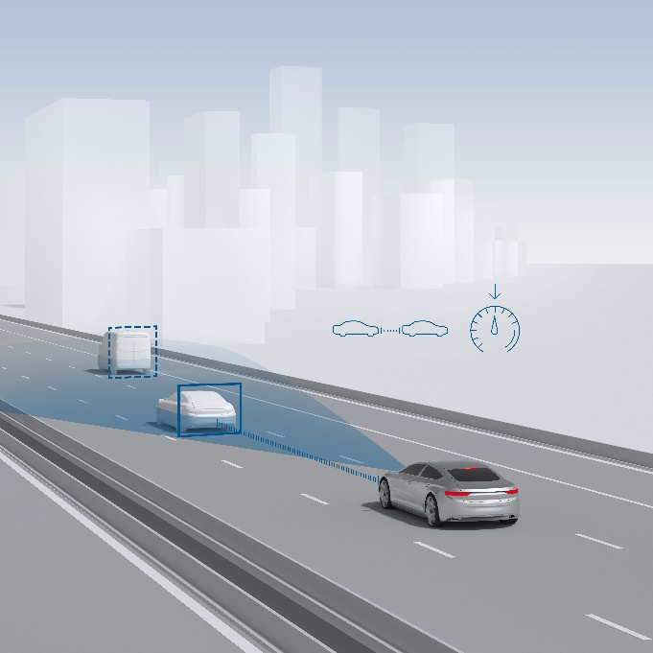


Adaptive cruise control base
Feature description
Customer benefits
Increase in driving comfort: relieve from adjusting speed and safety distance to current traffic situation
Natural comfort braking when approaching a preceding, slower vehicle
Increase in safety: reduces speed already before any Automatic emergency braking (AEB) feature is triggered
For OEMs: different scalable technology solutions available
Feature description
The Adaptive cruise control base extends the standard cruise control with an automatic adjustment of the speed and distance to the preceding vehicle.
Speed range: 30 kph – 250 kph (maximum speed depending on sensor set)
Distance to preceding vehicle can be adjusted by driver
Comfortable speed adaptations inside curves (Value-add feature: Curve speed controller)
Required technology elements
Diverse sensor solutions available:
(1) Standard & recommended: Front Radar and Front Video
(2) Front video only (with performance limitations)
(3) Front Radar only (with performance limitations)
PRID0041

Slide 12
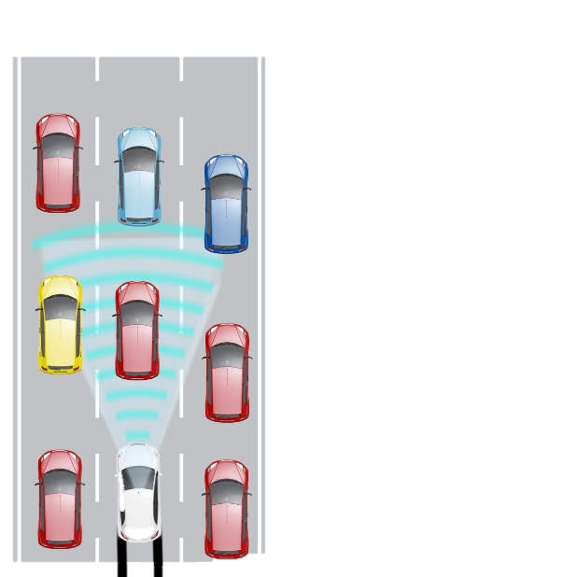
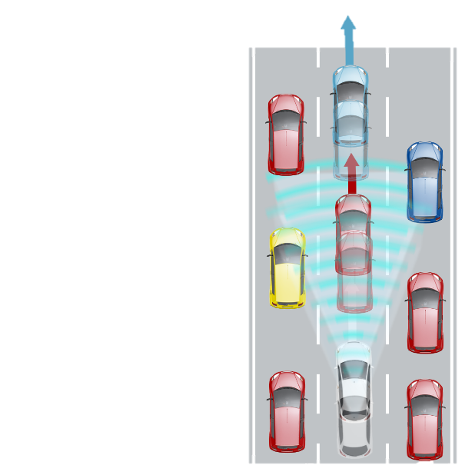
Adaptive cruise control stop & go
Feature description
Customer benefits
Increase in driving comfort: relieve from adjusting speed and safety distance to current traffic situation even in stop & go situations
feature can be used within the complete speed range
For OEMs: different scalable technology solutions available
Feature description
The Adaptive cruise control stop & go extends the standard ACC base with an automatic adjustment of the speed and distance to the preceding vehicle in stop & go traffic situations.
Speed range: 0 kph – 250 kph (max. speed depending on sensor set)
Automatic resume within 3s after ego vehicle stand still
Starts the engine when direct preceding vehicle is driving off
Optional sub feature: Braking on standing objects available
Required technology elements
Diverse sensor solutions available:
(1) Standard & recommended: Front Radar and Front Video
(2) Front video only (with performance limitations)
(3) Front Radar only (with performance limitations)
Automatic transmission
Support of standstill management based on braking system (e.g. Automatic parking brake)
PRID0007

Slide 13
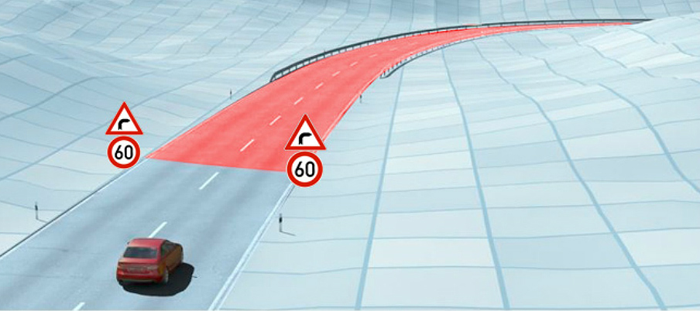
Adaptive cruise control plus
Feature description
Customer benefits
Increased comfort: less driver interaction required, more natural driving style
Supports Euro NCAP: points for (1) automatic ACC set speed adaptation or (2) offer to the driver to change manually the set speed
Increase in safety: speed limits are always followed and over speeding in curves is avoided
Feature description
The Adaptive cruise control plus extends the ACC stop & go with a predictive, automatic speed adjustment according to the actual speed limit and to characteristics of the road radius.
Implicit and explicit speed signs are recognized (with feature: Road sign information)
Predictive and comfortable speed adaptations before curves (optional value-add available for more complex use cases, like intersections)
Automatic or confirmed adaptation modes supported
Required technology elements
Diverse sensor solutions available:
(1) Standard & recommended: Front Radar and Front Video
(2) Front video (with performance limitations)
Feature: Road sign information
Map with curve radius and road sign attributes
PRID0005

Slide 14
Value-add feature description

Slide 15
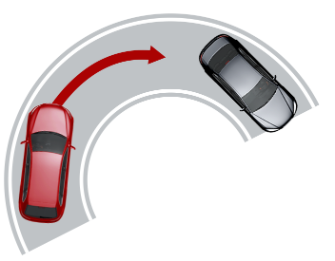
Curve speed controller
Value-add feature description
Standard
ACC plus
Standard
ACC stop & go
Standard
ACC base
Customer benefits
Keeps target speed in case of loss of target object in curves
Increases safety and comfort in curves if ACC target speed setting is too high (avoids the need to cancel ACC)
For OEMs: cost efficient solution without additional technology elements
lateral acceleration
Feature description
The Curve speed controller controls the lateral acceleration by reducing the ego vehicle speed inside curves.
The allowed maximum lateral acceleration can be adjusted vehicle individually according to OEM requirements
A speed dependency can be applied to the allowed maximum lateral acceleration
The maximum allowed lateral acceleration can be adjusted for different driving modes of the vehicle
Required technology elements (additional to main feature)
No additional technology element necessary
Optional: Roundabout information to optimize controller inside roundabouts:
Unplausible acceleration inside the roundabout will be suppressed
At the exit of the roundabout the acceleration is improved to avoid unnatural decelerations of the ego vehicle.
PRID0272

Slide 16






Personalized drive programs
Value-add feature description
Standard
ACC plus
Standard
ACC stop & go
Standard
ACC base
Customer benefits
Increased end user experience: “my personal ACC”
Completes personalized drive programs from engine, steering and others
Supports also consumption optimization modes like for example Eco modes
Sport+
Dynamic
Auto
Eco
Comfort
Sport
Efficiency
Individual
Feature description
The Personalized drive programs adapts the ACC dynamic behavior using predefined settings
The dynamic behavior can be adjusted by OEM in each program and can be combined with other drive programs (e.g. from engine management)
Several drive programs are supported
Regional specific applications are supported
Required technology elements (additional to main feature)
HMI concept and signal interface to provide information about selected drive program
PRID0273

Slide 17
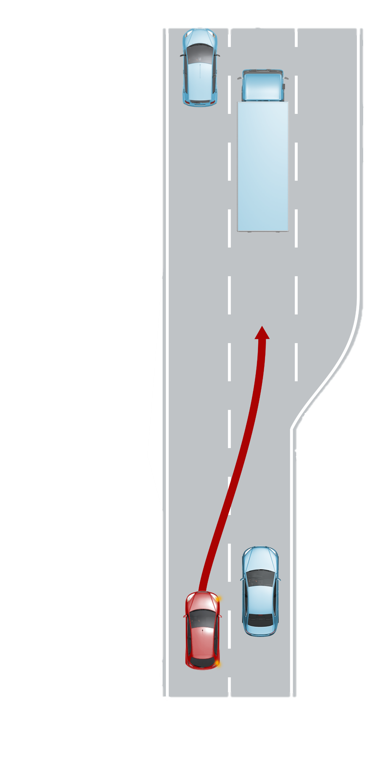
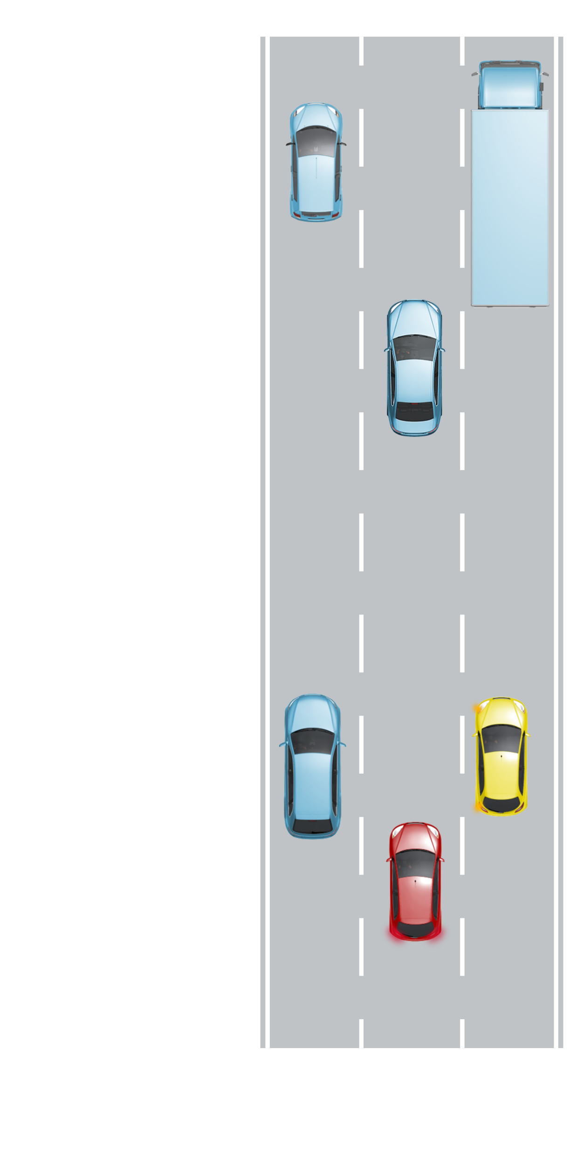

Cooperative behavior
Value-add feature description
Optional
ACC plus
Optional
ACC stop & go
Optional
ACC base
Customer benefits
Improves overall traffic flow by considering neighboring lane vehicles and their behavior
Increases the natural driving behavior of the main feature
Reduced driver interactions
(1)
(2)
>
Feature description
The Cooperative behavior reacts to neighboring vehicles both (1) when the driver indicates a lane change or (2) when a neighboring vehicle intends a lane change to the ego lane due to a slower preceding vehicle.
(1) Speed reduction to position ego vehicle at a gap of the neighboring vehicles to allow lane change of ego vehicle
(2) Gap to preceding vehicle is increased to allow neighboring vehicle a lane change into ego lane
Required technology elements (additional to main feature)
No additional technology element necessary
PRID0280

Slide 18
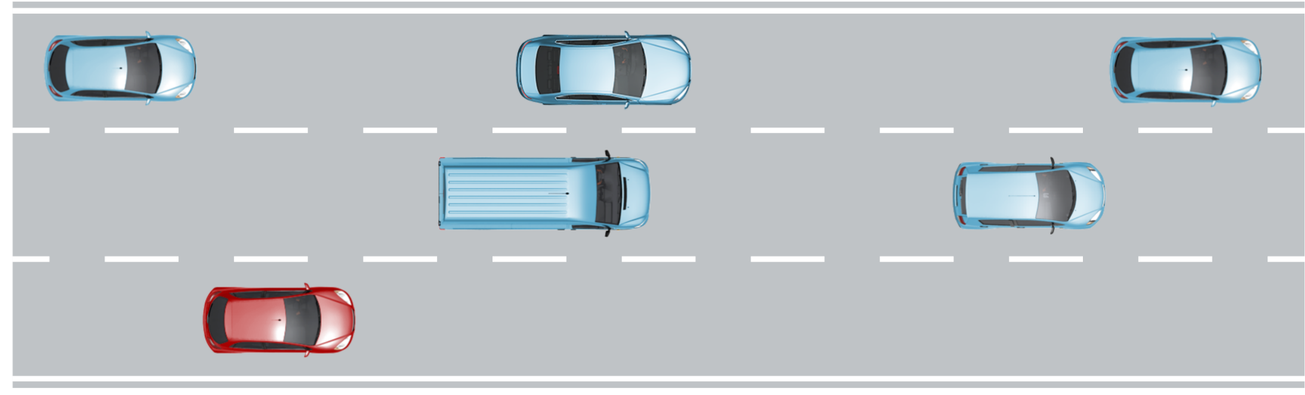

Wrong side overtaking avoidance
Value-add feature description
Optional
ACC plus
Optional
ACC stop & go
Optional
ACC base
Customer benefits
Prevents the driver to cancel ACC in case of a wrong side overtaking scenario
Supports driver to increases safety while ACC is active
Feature description
The Wrong side overtaking avoidance prevents an unwanted overtaking at the ‘wrong’ side while ACC is active.
Ego vehicle keeps distance to preceding vehicle in the neighboring lane
Related traffic rule applies to some target countries
Required technology elements (additional to main feature)
Geofencing if required for specific target country and road selection (according to the state specific legal conditions)
PRID0203

Slide 19
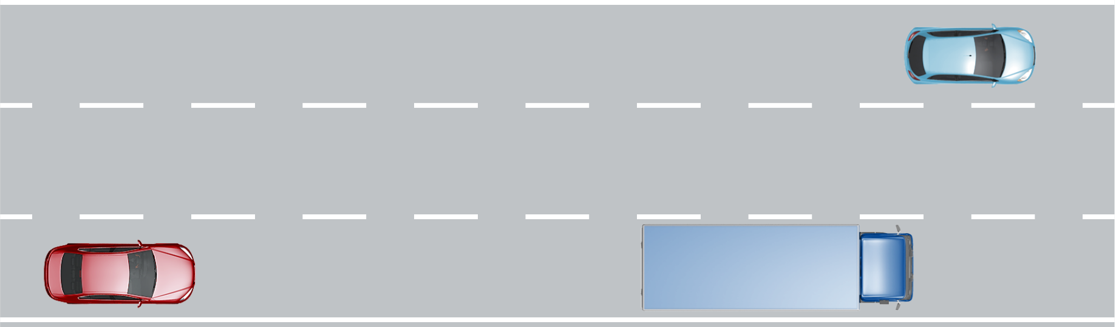
Overtaking support
Value-add feature description
Optional
ACC plus
Optional
ACC stop & go
Optional
ACC base
Customer benefits
Less interaction of driver needed
Natural driving behavior on multiple lane roads while overtaking
Supports natural traffic flow
Set-speed: 130kph
Speed increase
80kph
80kph
Feature description
The Overtake support increases speed of ego vehicle if driver intends to overtake (driver triggered by turn indicator)
If driver does not perform overtaking maneuver, speed and distance will again be adapted to preceding vehicle
An increase of the ego speed is verified against preceding or overtaking vehicles on the neighboring lane
Required technology elements (additional to main feature)
Recommended: Rear corner radar for blind spot scenarios
PRID0215

Slide 20
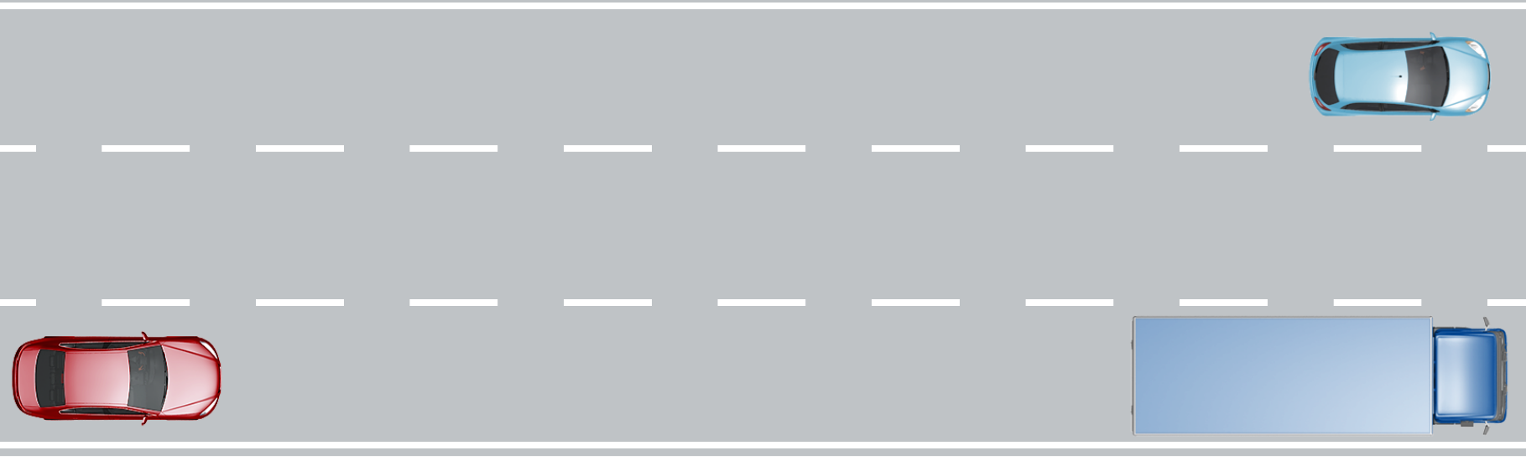
Predictive overtaking support
Value-add feature description
Optional
ACC plus
Optional
ACC stop & go
Optional
ACC base
Customer benefits
Less interaction of driver needed
Keeps ego vehicle target speed in standard lane change use cases
Natural driving behavior on multiple lane roads while overtaking
Predicted driver intention
120kph
80kph
Feature description
The Predictive overtaking support foresees the driver intention to change the lane due to an overtaking scenario (free neighboring lane and slower preceding vehicle). It assists the driver by avoiding unnecessary decelerations due to the preceding vehicle.
Ego vehicle speed is kept longer, and deceleration is delayed due to the slower preceding vehicle
If driver is not starting the lane change, higher deceleration is applied to keep safety distance
Required technology elements (additional to main feature)
Rear corner radar for blind spot scenarios
PRID0274

Slide 21
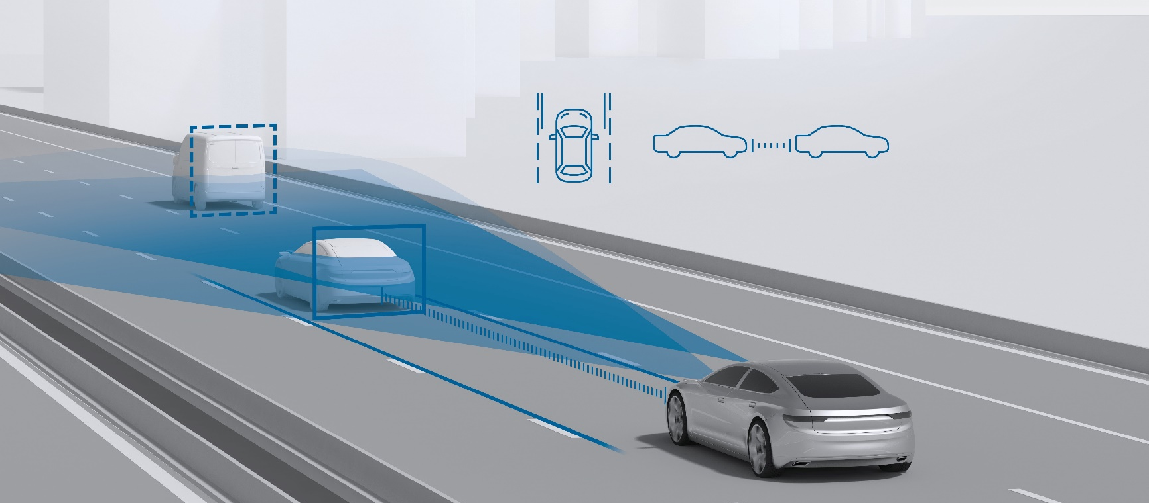
Eco drive mode*
Value-add feature description
Optional
ACC plus
Not available
ACC stop & go
Not available
ACC base
Make ADAS features drive more energy-efficiently
Customer benefits
Increase energy-efficiency of ADAS (~5%** for EVs)
Solution integrated within ADAS features yields the best system optimum of powertrain and assisted features
For consumers: increased vehicle driving range, reduced energy cost, more relaxed driving
For OEMs: increase vehicle driving range or decrease battery size, green image, not relevant to OBD regulations
Feature description
Eco drive mode is a comprehensive, pre-integrated Bosch solution to make ADAS features drive more energy-efficiently
Eco drive mode is activated by the driver
Energy efficient driving using road geometry and topology information (based on map data and environment perception)
Implementation of energy-efficient speed optimization integrated in AD / ADAS architecture in cooperation with the powertrain and engine management
Required technology elements (additional to main feature)
Optional: Map with road gradient information
*Concept phase, timing and content not finalized yet
** based on in-house simulation
PRID0202

Slide 22
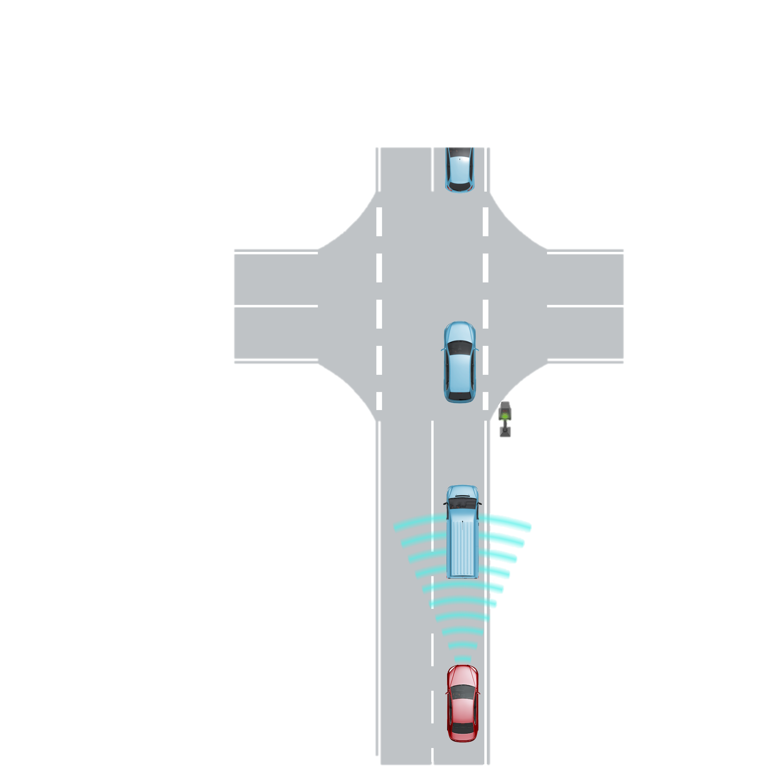

ACC engine start base
Value-add feature description
Standard
ACC plus
Standard
ACC stop & go
Not available
ACC base
Customer benefits
Prepares a drive-off scenarios by decreasing the reaction time
Reminds the driver using feedback from the engine start to resume ACC (in case a manual ACC resume is necessary)
Feature description
The ACC engine start base initiates the start of the engine when the direct preceding vehicle drives off.
The start of the engine is only initiated after the ego vehicle came to a complete stop behind a preceding vehicle and the engine was turned off by the Start/Stop system.
The feature is only starting the ego vehicles engine, no drive-off
Required technology elements (additional to main feature)
No additional technology element necessary
PRID0212

Slide 23
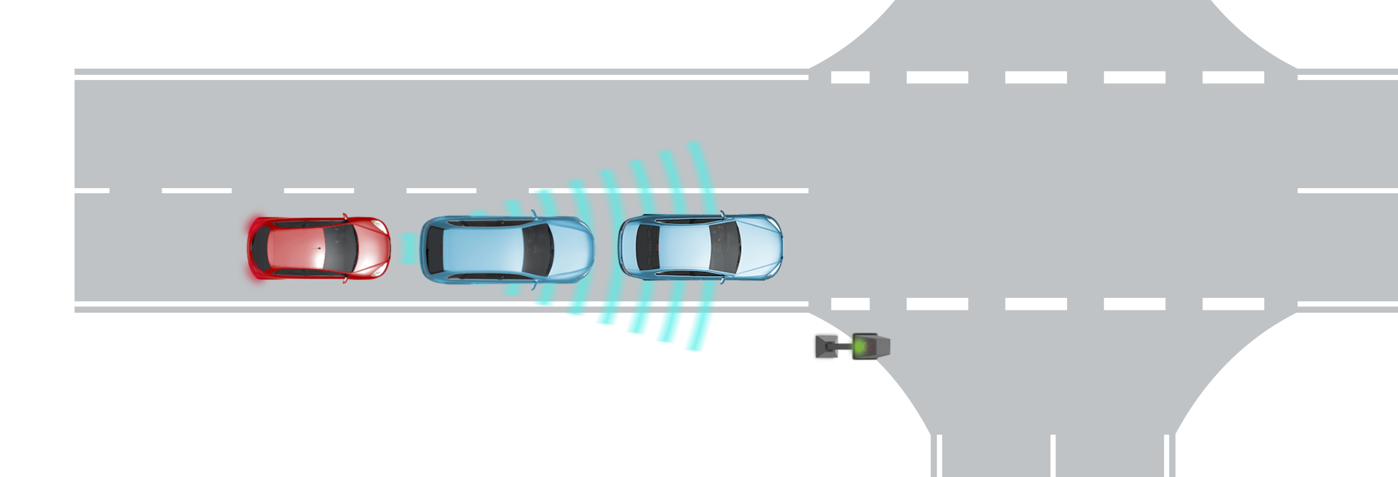
ACC engine start plus
Value-add feature description
Optional
ACC plus
Optional
ACC stop & go
Not available
ACC base
Customer benefits
Very early preparation in drive-off scenarios by decreasing the reaction time
With the support of ACC passive mode this sub feature can always be offered to the driver
Reminds the driver using feedback from the engine start to resume ACC (in case a manual ACC resume is necessary)
Feature description
The ACC engine start plus adds additional features to the base version:
Initiates the start of the engine when the pre-preceding vehicle drives off
Feature can be active in ACC passive mode
Required technology elements (additional to main feature)
No additional technology element necessary
PRID0291

Slide 24
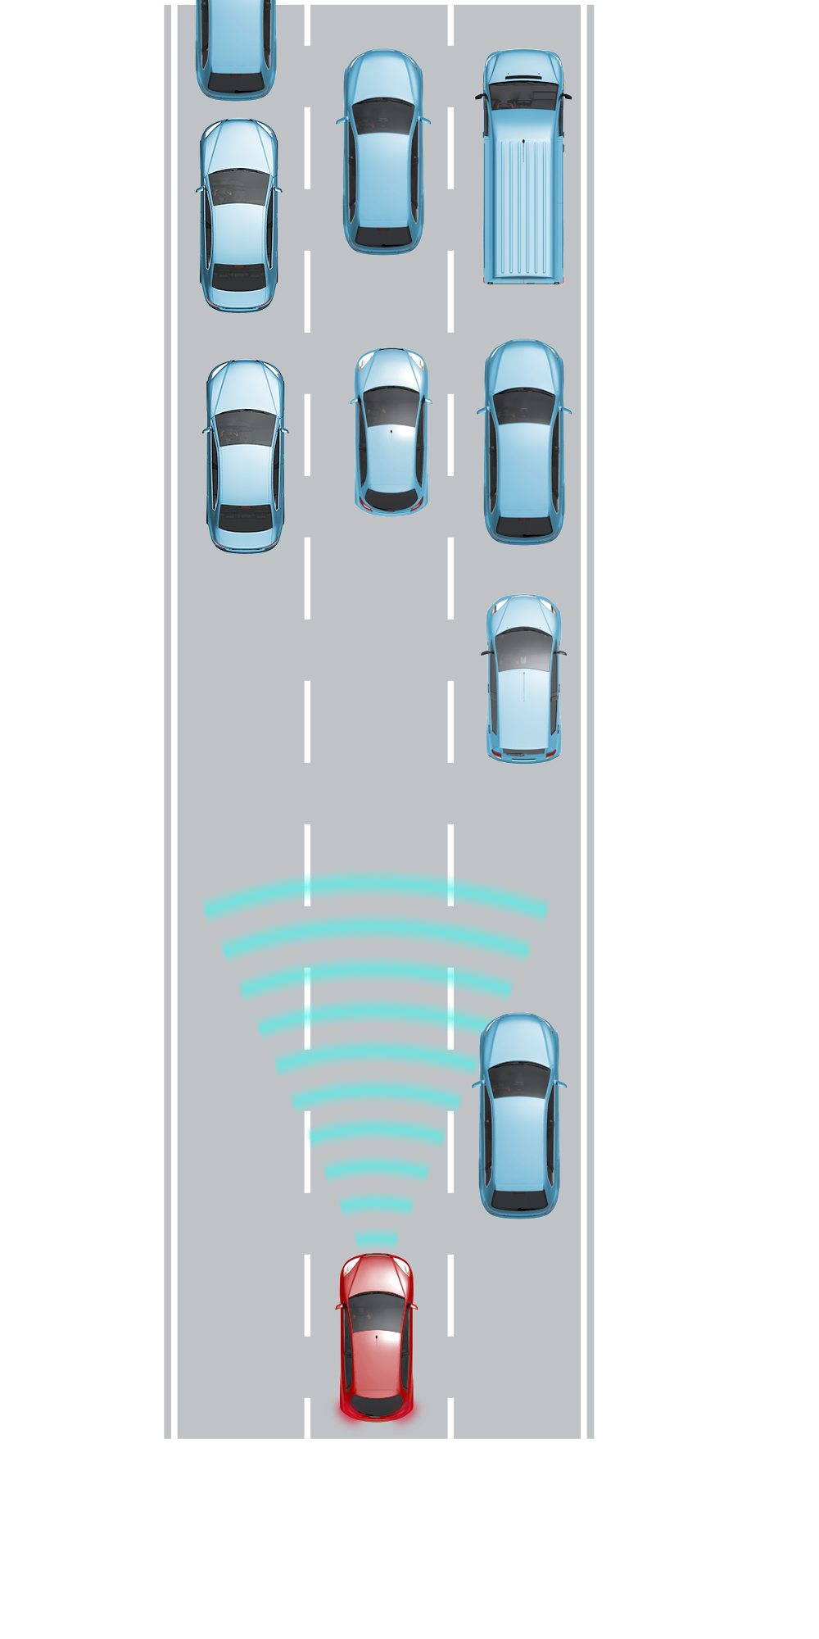
Braking on standing objects
Value-add feature description
Standard
ACC plus
Optional
ACC stop & go
Not available
ACC base
Ego vehicle max speed: 60kph
Ego vehicle max speed: 80kph
Ego vehicle max speed: 130kph
Feature description
Customer benefits
Increases safety by reducing the ego vehicle speed before AEB features are triggered
No interaction of driver needed when approaching a standing vehicle
The Reaction on standing objects decelerates comfortably to standing vehicles in the ego lane.
Feature is active below an ego vehicle speed of:
V1: 60kph
V2: 80kph
V3*: 130kph
Required technology elements (additional to main feature)
Front video mandatory
V3*: Localization on road level
PRID0213
*Concept phase, timing and content not finalized yet

Slide 25
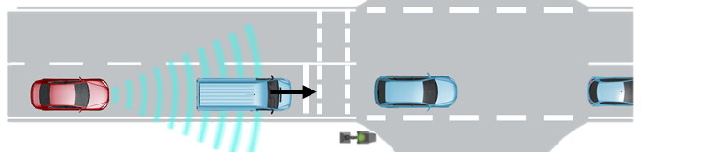
Automatic resume plus
Value-add feature description
Optional
ACC plus
Optional
ACC stop & go
Not available
ACC base
30 seconds
No time limitation
30
∞
Feature description
ACC stop & go and ACC plus include an automatic drive-off after the preceding vehicle moves off. The Auto-resume time window is extended to 30s (V1) or unlimited (V2).
V1: Automatic resume plus active within 30s after ego vehicle standstill
V2*: Automatic resume plus active without any time limitations
Customer benefits
The driver does not need to resume the ACC feature manually
Less interaction of driver needed
Increased comfort in dense traffic scenarios
Required technology elements (additional to main feature)
For V1: Front Radar, Intruder detection support (by e.g., Front camera, Near range cameras or Ultra sonic sensors); Optional: Driver monitoring camera with driver attentiveness detection
For V2*: In concept phase
PRID0275
*Concept phase, timing and content not finalized yet

Slide 26




Right of way support
Value-add feature description
Optional
ACC plus
Not available
ACC stop & go
Not available
ACC base
Warnings
Complete stop*
Warnings and speed reductions
Complete stop or speed reduction
Feature description
Customer benefits
Extends the availability of ACC to stop/yield signs, traffic lights and more
Supports driver to increase safety while ACC is active
The Right of way control reacts to stop/yield signs and red traffic lights while ACC is activated. The feature is upgraded constantly over time.
V1: while approaching a stop or a yield sign a warning is displayed and the ego vehicle speed is reduced to support the warning to the driver
V2: while approaching a red traffic light the driver is warned and the ego vehicle speed is reduced to support the warning to the driver
V3: ego vehicle comes to a complete stop at a stop sign or at a yield sign the ego speed is reduced accordingly; At other infrastructure elements like bumpers or crosswalks the ego vehicle speed is reduced accordingly
V4*: at a red traffic light the ego vehicle comes to a complete stop
Required technology elements (additional to main feature)
V1/V2: Localization on road level (e.g. Road signature base); Behavior and hazard map (Map base)
V3 / V4*: Localization on lane level (e.g. Road signature enhanced); XD map (Map enhanced)
PRID0282
*Concept phase, timing and content not finalized yet

Slide 27
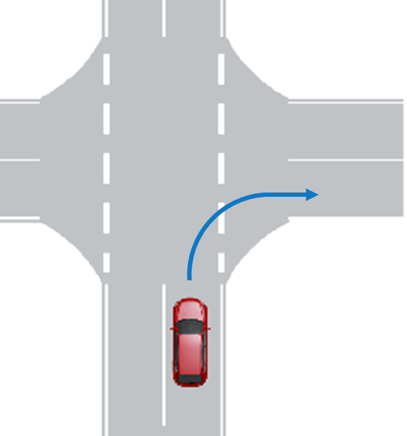



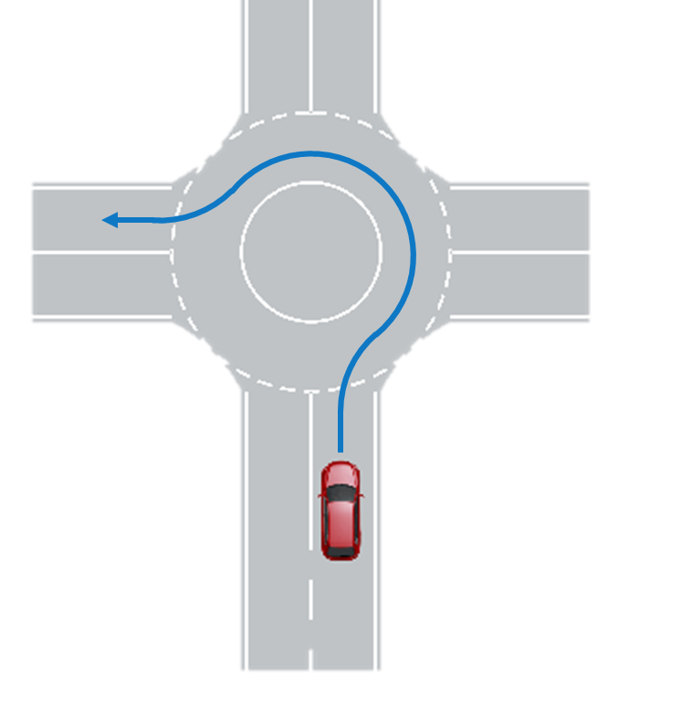

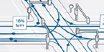
Adaptation to road radius
Value-add feature description
Standard
ACC plus
Not available
ACC stop & go
Not available
ACC base
Speed adaptation based on traffic behavior information
Speed adaptation to curve radius
Speed adaptation following navigation route or vehicle indicator
Feature description
The Road topology adaptation feature adjusts the ACC vehicle speed to the road geometry in a predictive manner.
V1: speed adaptation to curve radius including round abouts
V2: speed adaptation at intersections or any other lane splits using navigation route information and/or vehicle indicator
V3: Additional usage of traffic behavior speed information (swarm data) to adjust speed for curves and turns.
Customer benefits
Increases safety and comfort in curves if ACC target speed setting is too high for the given road geometry
Avoids the need to cancel ACC in curves
Keeps target speed in case of loss of target object in curves
Required technology elements (additional to main feature)
V2: Map with radius information of intersections
V3: - Bosch connected map service (behavior layer)
- Connected horizon
- Mobile communication unit
PRID0281

Slide 28
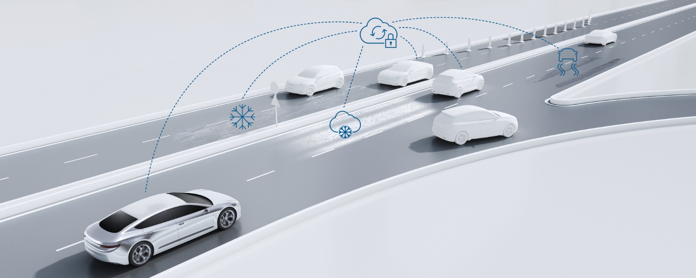
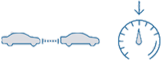
Adaptation to road hazards*
Value-add feature description
Standard
ACC plus
Optional
ACC Stop & Go
Not available
ACC base
Customer benefits
Increase of safety and comfort in a pro-active and predictive way for drivers using ACC
Increased natural driving behavior
After 2023/25, road hazards will most likely be NCAP and IIHS relevant
Feature description
The Road hazard adaptation feature considers cloud-based environmental information to adapt safety distance and driving speed to the actual driving condition pro-actively before the vehicle is encountering a supported hazardous situation, e.g:
Road surface condition: slippery road
Road hazards: obstacle, accident, breakdown or wrong way driver vehicle
Visibility hazards: fog, smoke or heavy rain/snow
V1: confirmation of adaptation by driver (SOP Q2/2022)
V2: automatic adaptation without driver confirmation (SOP Q1/2024)
Required technology elements (additional to main feature)
Bosch connected map service (road hazard layer)
Connected horizon
Mobile communication unit
PRID0076
*Concept phase, timing and content not finalized yet

Slide 29
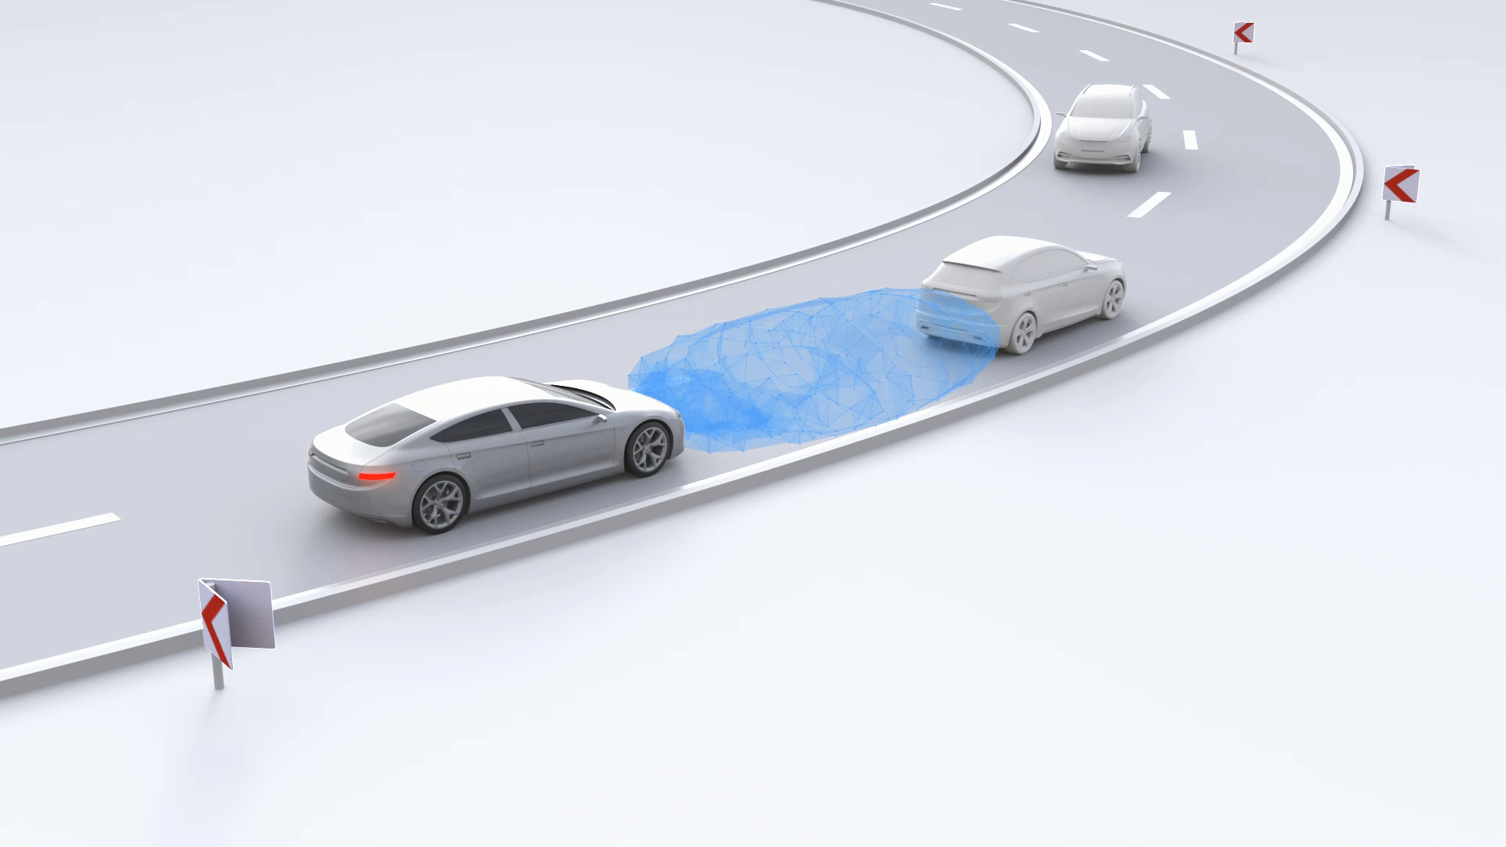
Adaptive distance control
Value-add feature description
Optional
ACC plus
Optional
ACC stop & go
Not available
ACC base
Customer benefits
Closes the gap between ACC and AEB features
Increased safety due to an early and comfortable distance control before AEB features are triggered
Increased comfort for the driver: easy one pedal drive
In dense traffic situations: less driver adaptions of the accelerator pedal necessary
Very natural and intuitive driving experience
Usage of existing ACC hardware (including HMI)
Feature description
When driving yourself the Adaptive distance control ensures a comfortable distance to the preceding vehicle and takes over braking maneuvers.
The ego vehicle supports the driver in keeping a safe distance to the preceding vehicle by actively reducing the acceleration and controlling the deceleration
The distance to the preceding vehicle can be changed continuously by the driver using the accelerator pedal
Once activated, the feature is not deactivated by a brake application
The feature can be manually disengaged by the driver
Required technology elements (additional to main feature)
Front Radar
PRID0071

